Slide 1

Team 31: CARNEt Review
Pooja Tewari
Shivangi Chand
Siddharth Dhar
Sripath Mishra

Slide 2
Sripath Mishra

Slide 3




Backend

Slide 4
Siddharth Dhar

Slide 5
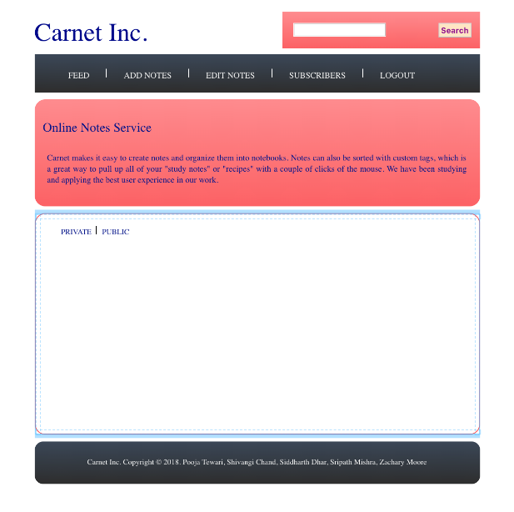

Slide 6
Shivangi Chand

Slide 7
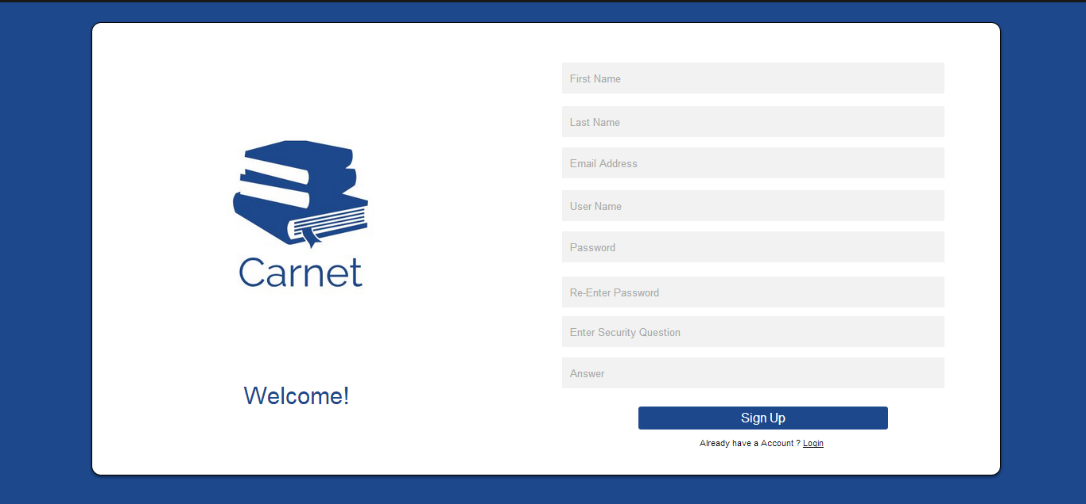

Slide 8
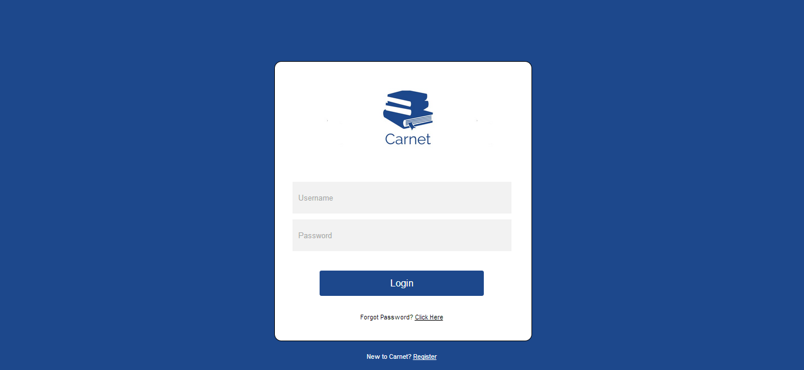

Slide 9
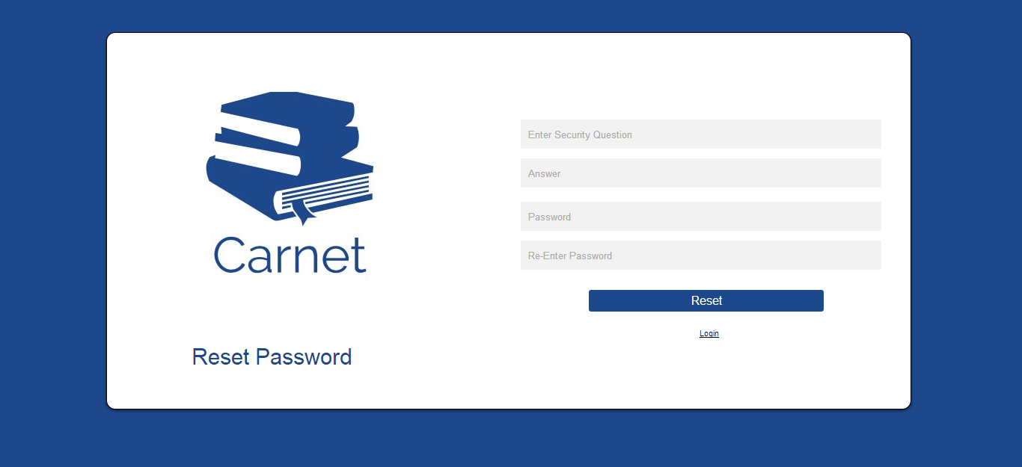

Slide 10
Pooja tewari

Slide 11


